Slide 1
The Trickster Archetype
Presenting: Lawrence Atmore, Nicole Balian, Marissa Canchola, Shannon Casarez, Alexia Magdaleno, Selina Alba Martinez, and Melody Symonds

Slide 2
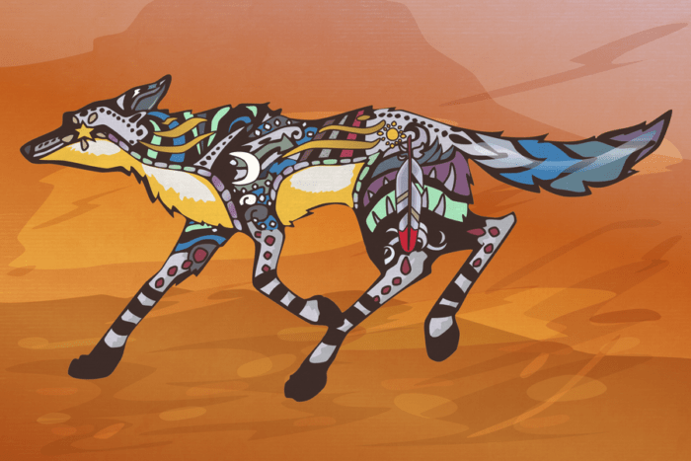
“The Embodiment of Ambiguities”
“Always hungry for another meal swiped from someone else’s kitchen, always ready to lure someone else’s wife into bed, always trying to get something for nothing, shifting shapes (and even sex), getting caught in the act, ever scheming, never remorseful” (247).
Arguably the most recognizable of all the mythological archetypes
Tricksters provide “real spark” in myth narratives – they reflect humanity.
  “The Trickster is myth come alive to meet us where we live.” (247).

Slide 3
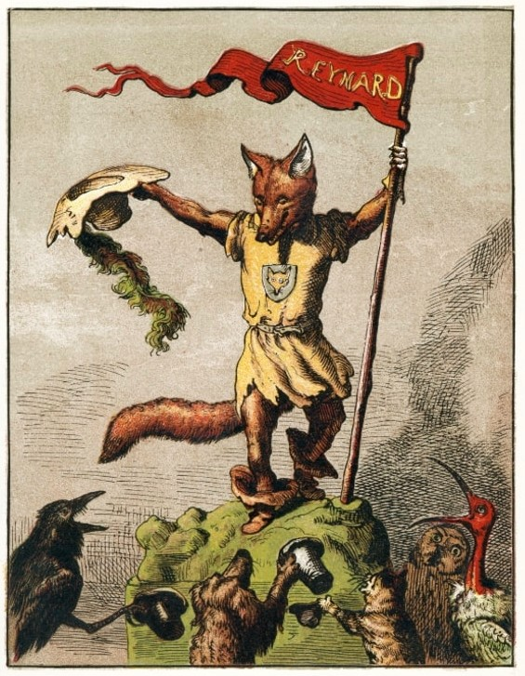
Trickster Traits
“No matter where in the world we find this unique character, he persistently displays humanity’s highest aspirations and our basest impulses” (250).
Complex figures of play
The comic relief of the mythological world
Often selfish and dishonest
Usually a shape-shifter
Agents of chaos who (usually) get away with their mischief

Slide 4
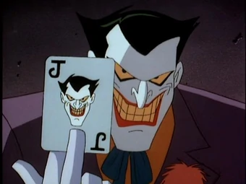
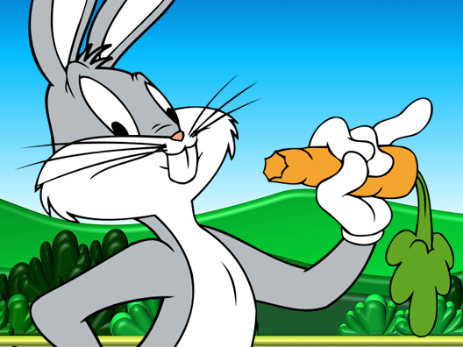
“Lords of the In-between”
“The Trickster does not suffer categorization lightly. He does not submit to the rules of his own society and will hardly sit still long enough for us to paint a clear picture of him, much less nail him down.” (252).
Tricksters are above all complicated figures that can take many different forms (literally).
Ten fundamental aspects of Tricksters: creator, culture-bringer, opportunist, mischief-maker, amorous adventurer, hunger-driven manipulator, credulous victim of others’ tricks, lazy work avoider, transgressor, and clown of the body.
Two very different characters. Both Tricksters!

Slide 5
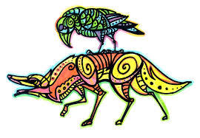
Tricksters Across Cultures
Tricksters take many forms across different cultures including: Loki (Norse), Reynard the Fox (European), Hermes (Greek), Ajapa and Anansi (African), Pa Pandir (Malaysian), Nasr-edden (Turkish)
Native American folklore have many different Trickster characters to offer, including Raven, Mink, Rabbit, Spider-man, and Blue Jay, but perhaps the best known is Coyote.

Slide 6
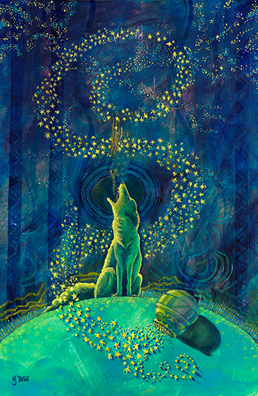
How Coyote Placed the Stars
“They look pretty good sitting there like that. I think I’ll leave it that way for everyone to see. Then when people look at them in the sky they will say, ‘There’s a story about that picture,’ and they will tell a story about me.” (268).
From the Wasco tribe
Details the story of how Coyote trapped a family of wolves in the sky to make the Big Dipper.
Coyote as creator, but also as the opportunist.

Slide 7
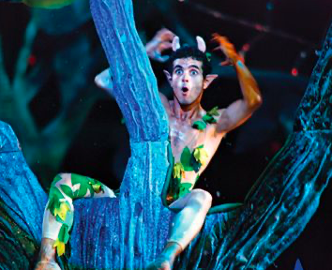
SCAFFOLDING ACTIVITIES
The Trickster Archetype

Slide 8
Scaffolding - Week One
Biographical Context for William Shakespeare
The Life of William Shakespeare - Check for Understanding Activity
A Midsummer Night’s Dream - Key Vocabulary
Act One - Dialectical Journal
Assigned Readings - Act I - A Midsummer Night’s Dream
A Midsummer Night’s Dream Discussion Questions - Act I
Socratic Seminar Friday
Students Submit Week One Dialectical Journal for Grading

Slide 9
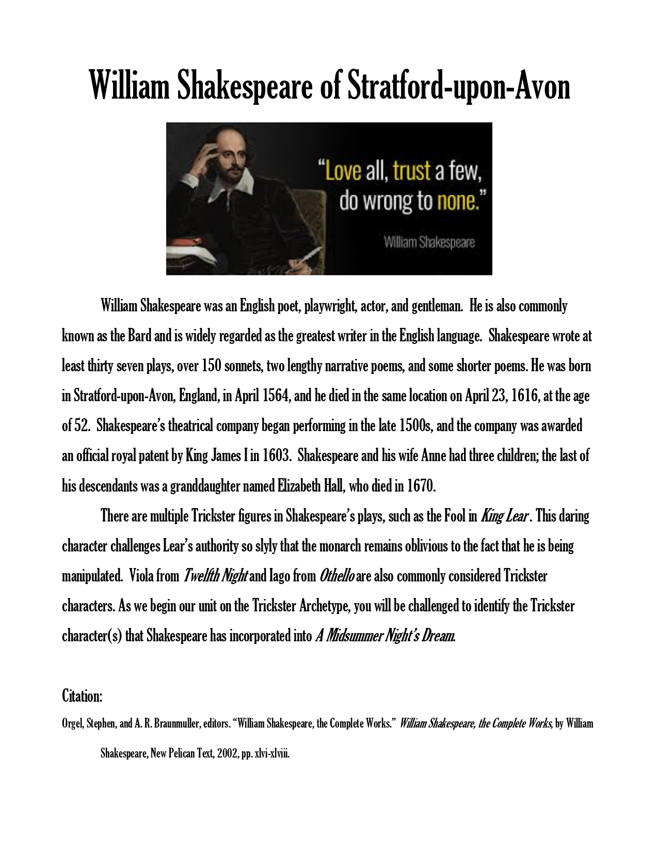
Biographical Context
William Shakespeare of Stratford-upon-Avon

Slide 10
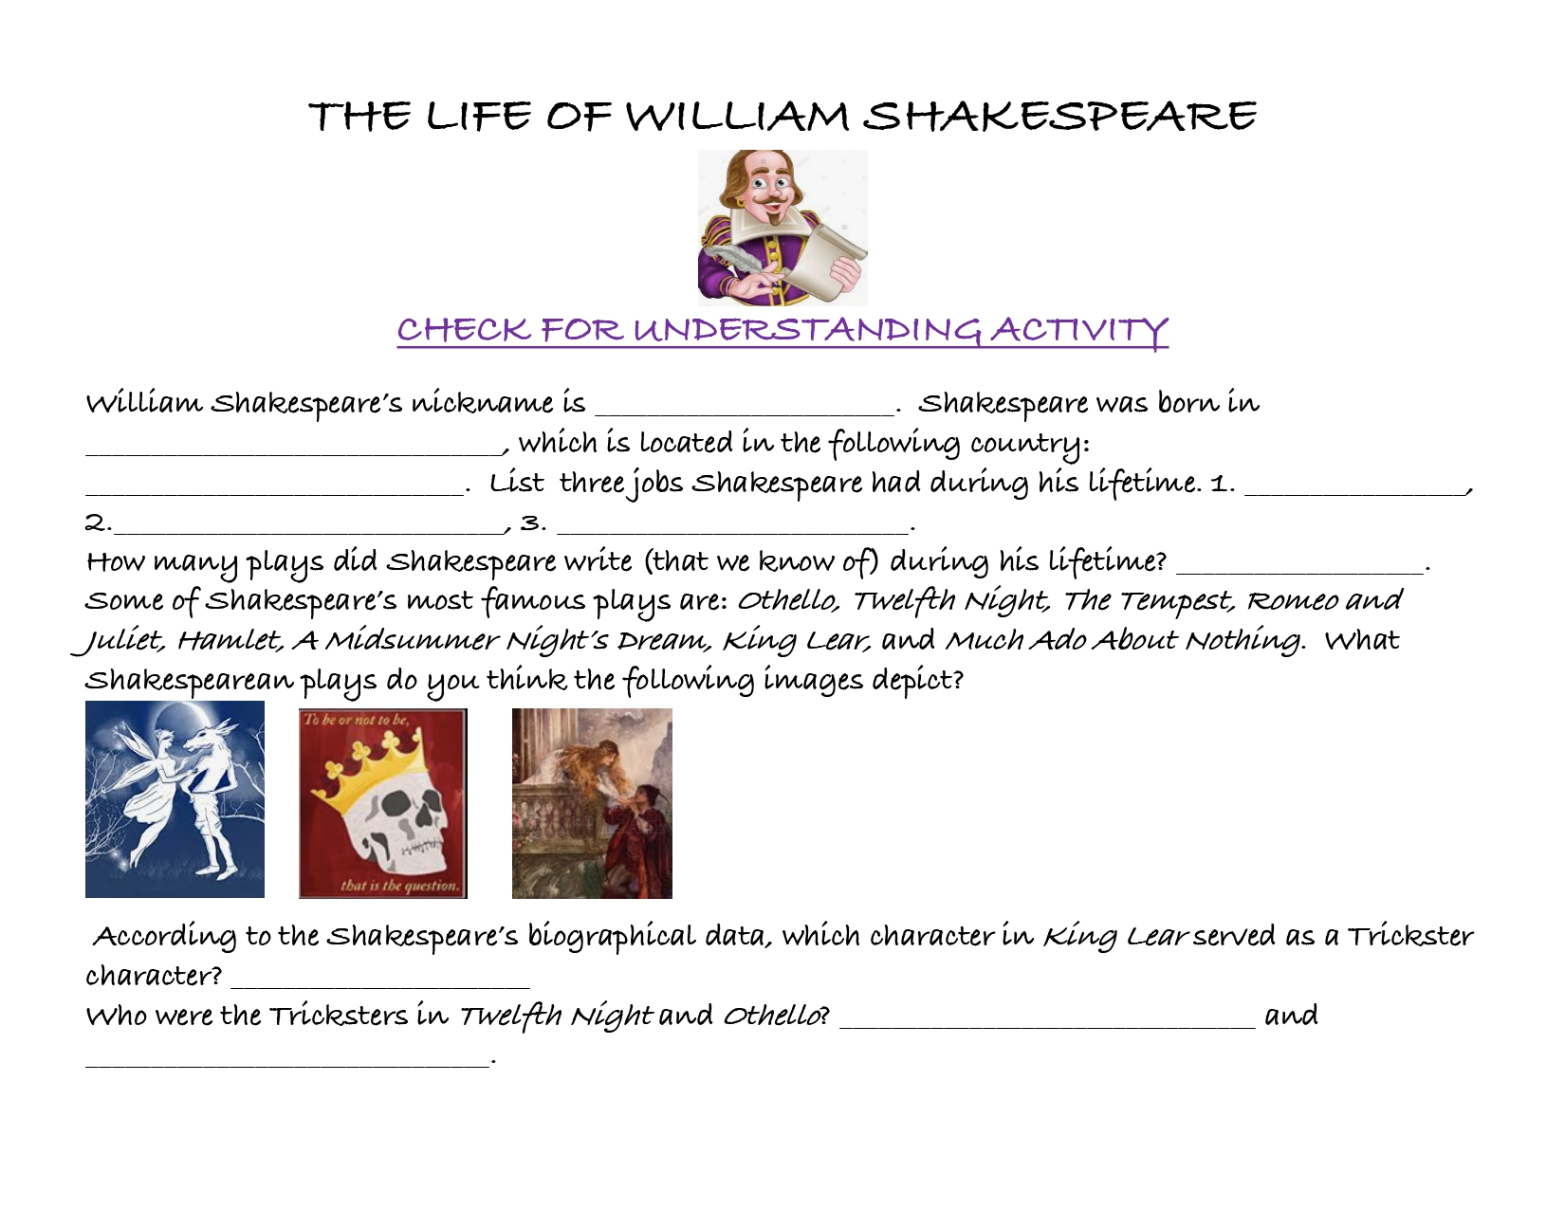

Slide 11
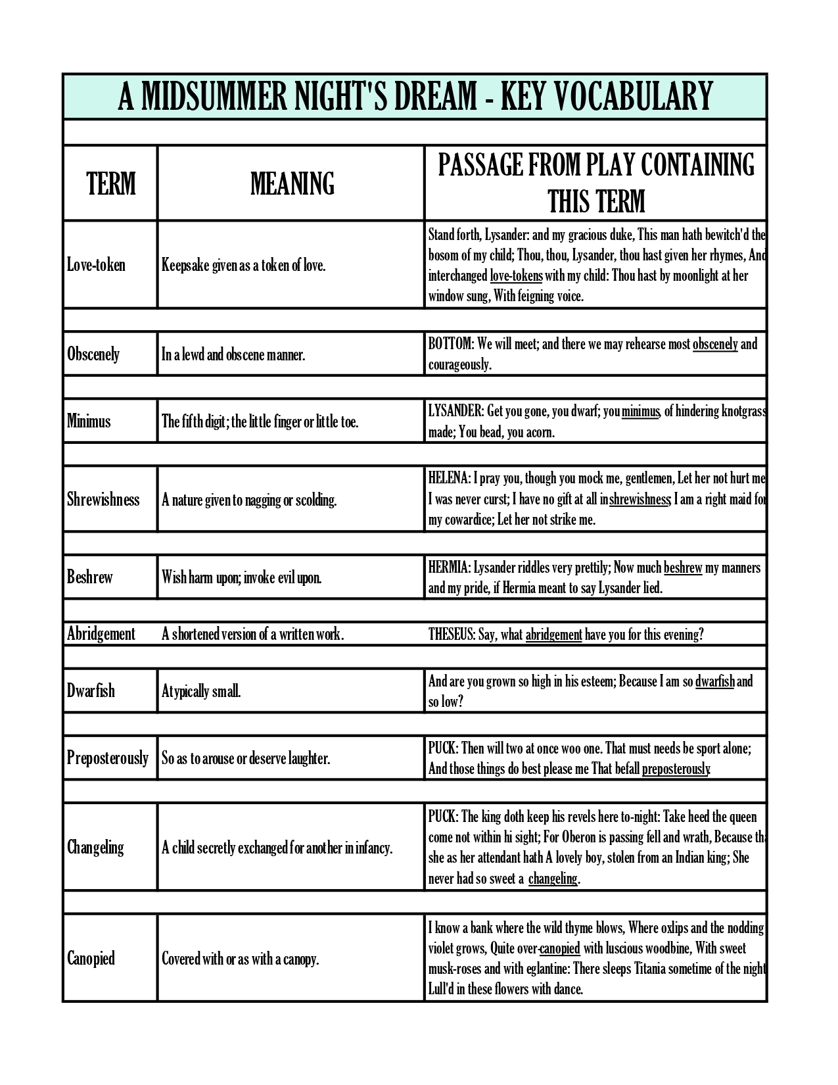
A Midsummer Night’s Dream
Key Vocabulary

Slide 12
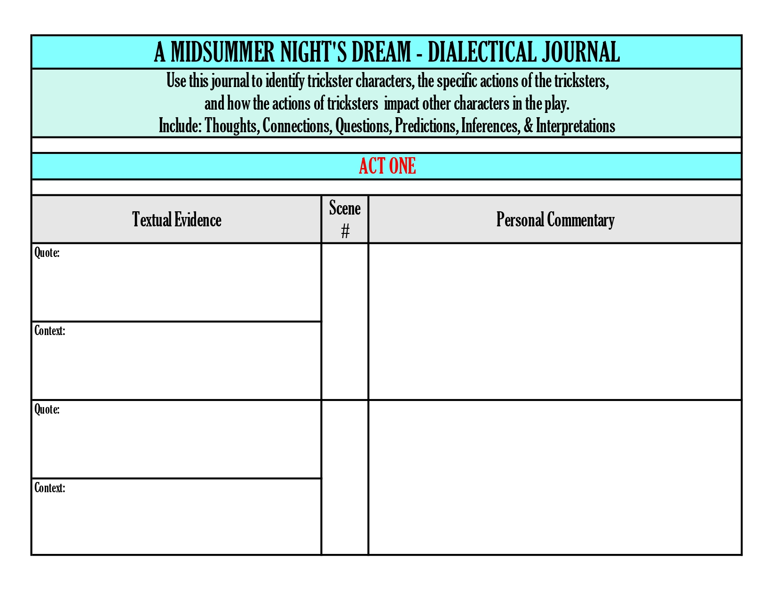
ACT I - DIALECTICAL JOURNAL

Slide 13
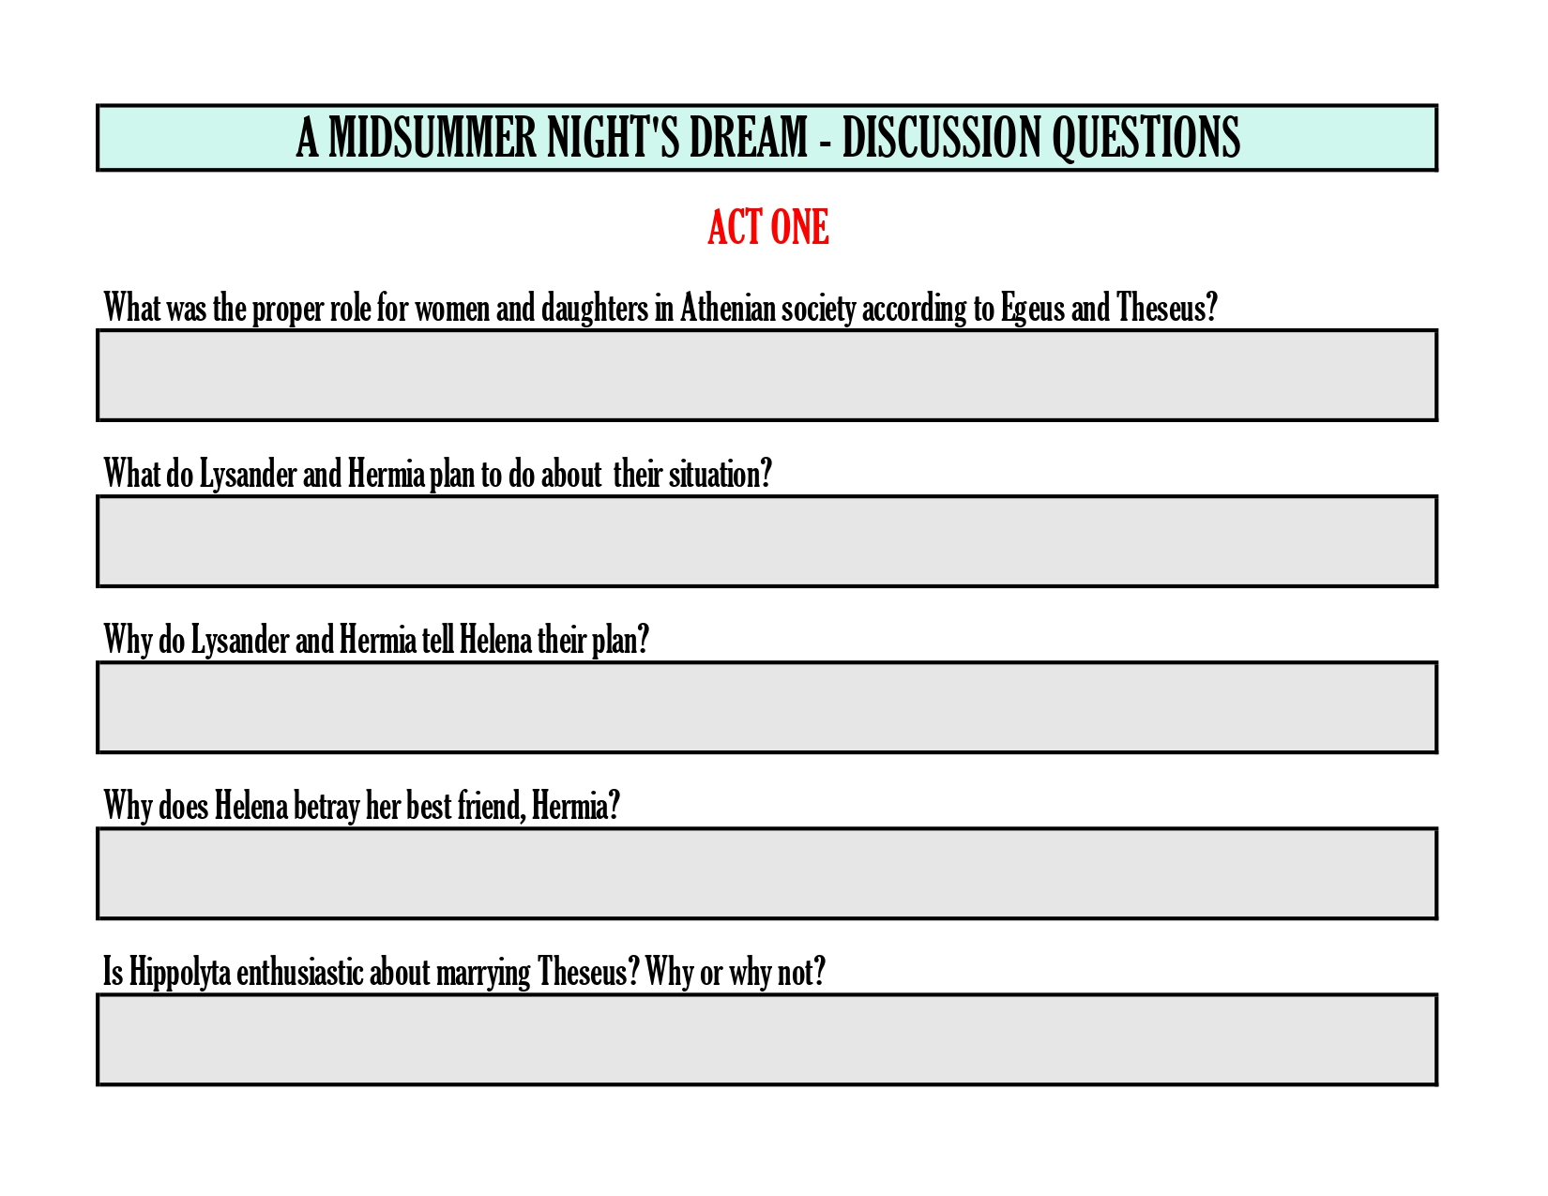
ACT I - DISCUSSION QUESTIONS

Slide 14
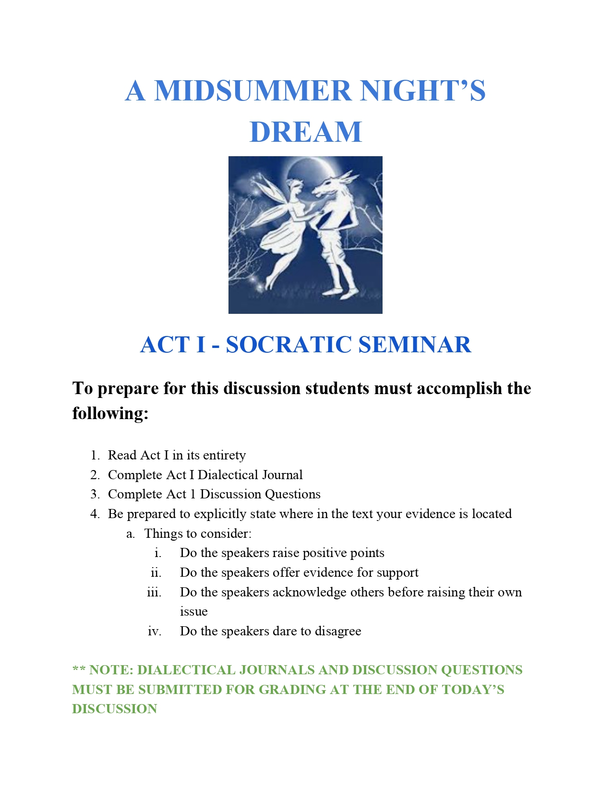
A Midsummer Night’s Dream
Socratic
Seminar
Friday

Slide 15
Scaffolding - Week Two
Act Two - Dialectical Journal
Assigned Readings - Act II - A Midsummer Night’s Dream
A Midsummer Night’s Dream Discussion Questions - Act II
Socratic Seminar Friday
Students Submit Week Two Dialectical Journal and Discussion Questions for Grading

Slide 16

ACT II - DIALECTICAL JOURNAL

Slide 17
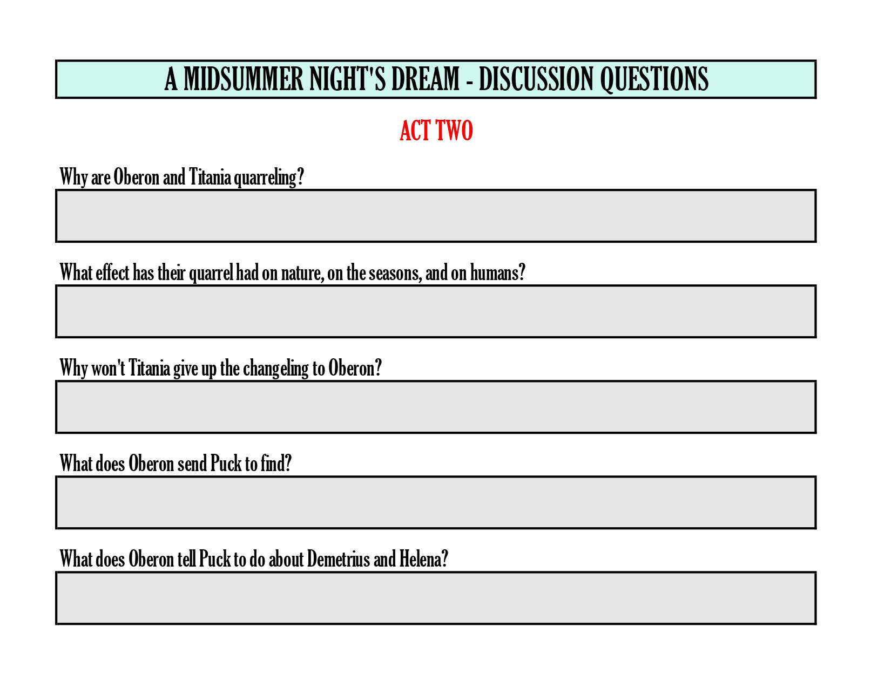
ACT II - DISCUSSION QUESTIONS

Slide 18

A Midsummer Night’s Dream
Socratic
Seminar
Friday

Slide 19
Scaffolding - Week Three
Act Three - Dialectical Journal
Assigned Readings - Act III - A Midsummer Night’s Dream
A Midsummer Night’s Dream Discussion Questions - Act III
Socratic Seminar Friday
Students Submit Week Three Dialectical Journal and Discussion Questions for Grading

Slide 20
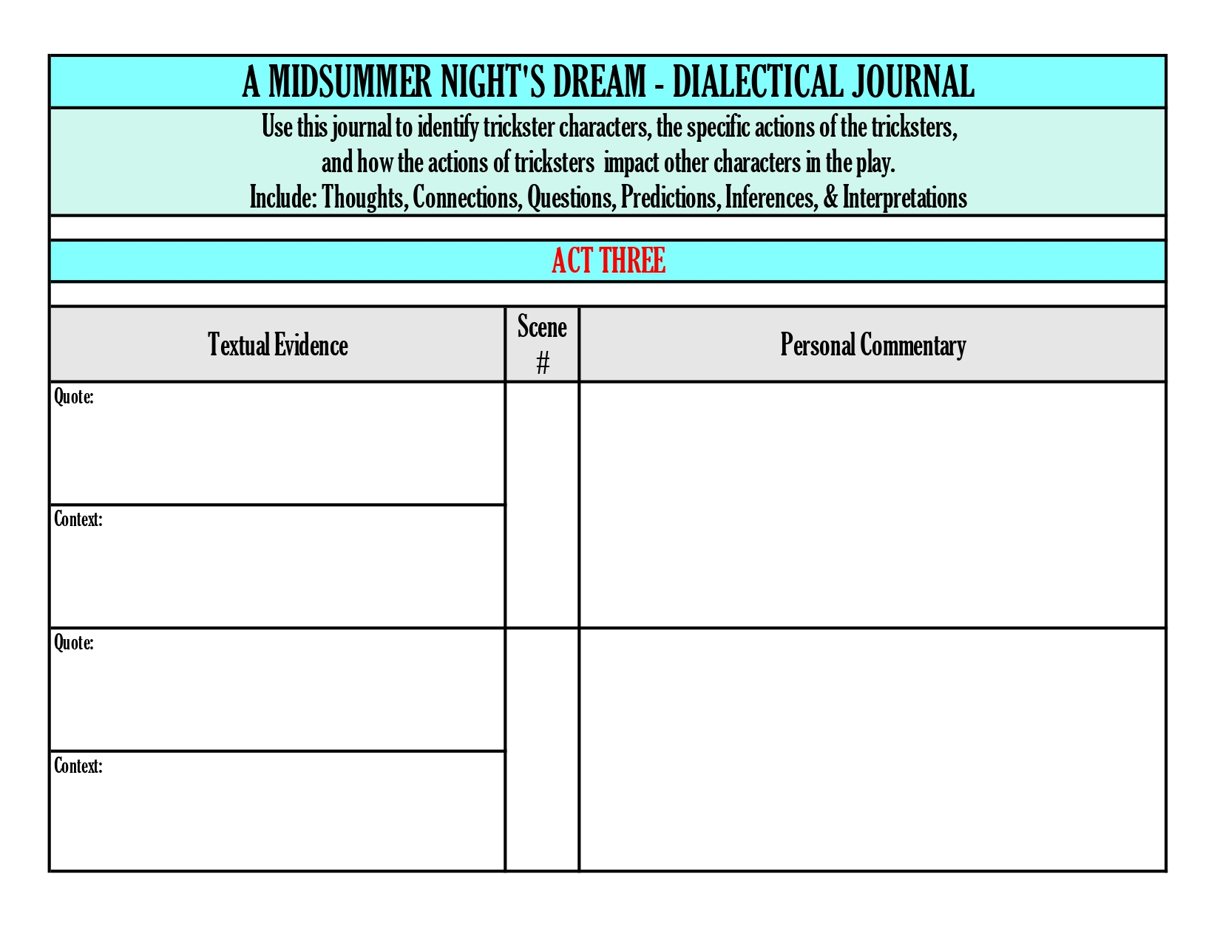
ACT III - DIALECTICAL JOURNAL

Slide 21
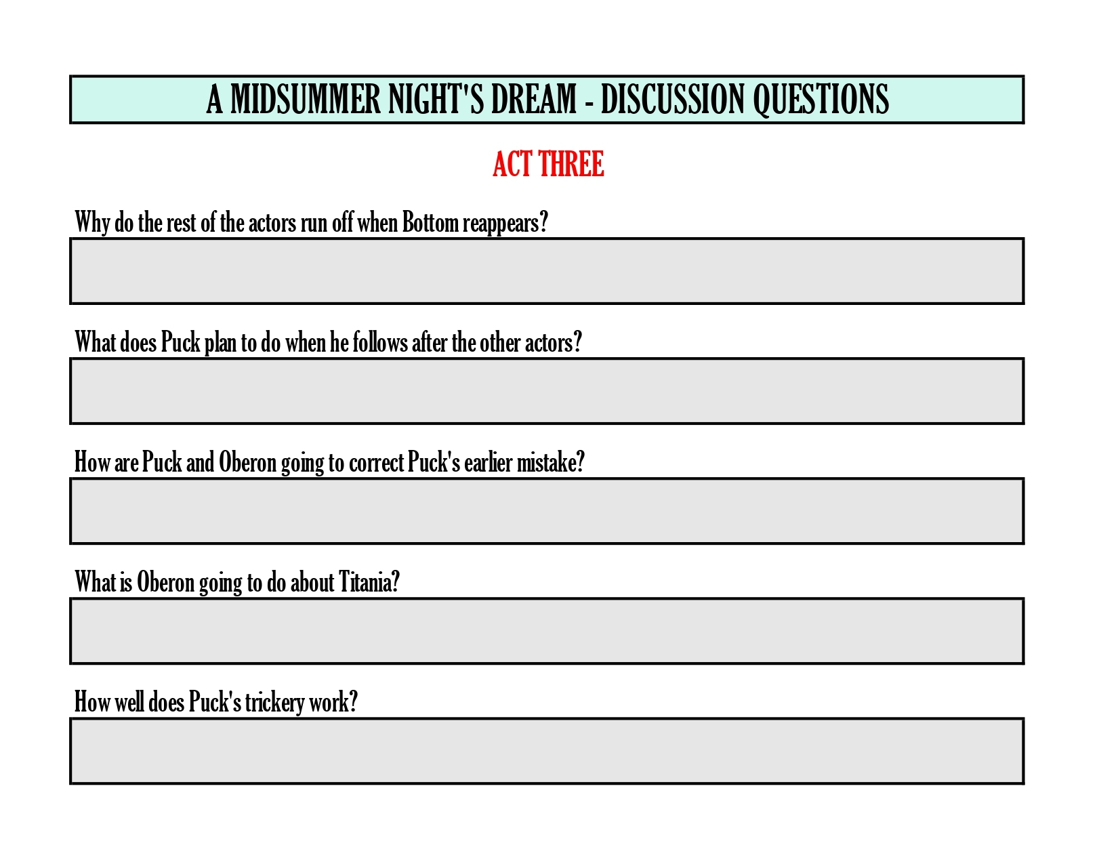
ACT III - DISCUSSION QUESTIONS

Slide 22

A Midsummer Night’s Dream
Socratic
Seminar
Friday

Slide 23
Scaffolding - Week Four
Act Four - Dialectical Journal
Assigned Readings - Act IV - A Midsummer Night’s Dream
A Midsummer Night’s Dream Discussion Questions - Act IV
Socratic Seminar Friday
Students Submit Week Four Dialectical Journal and Discussion Questions for Grading

Slide 24
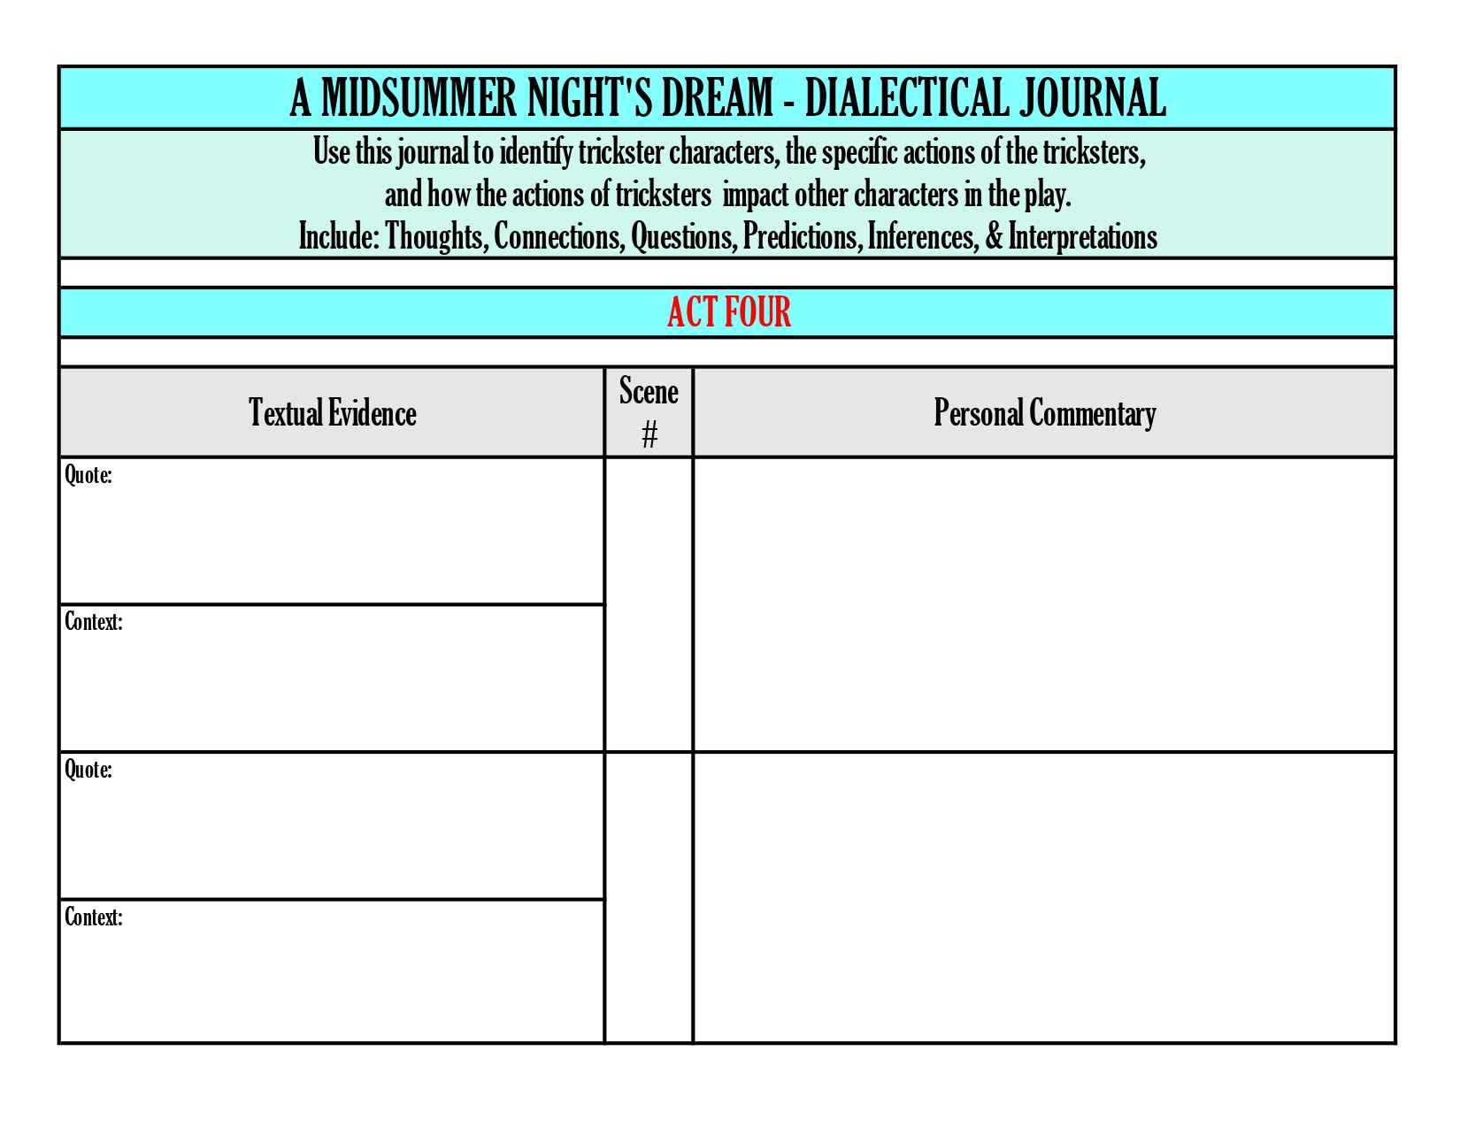
ACT IV - DIALECTICAL JOURNAL

Slide 25
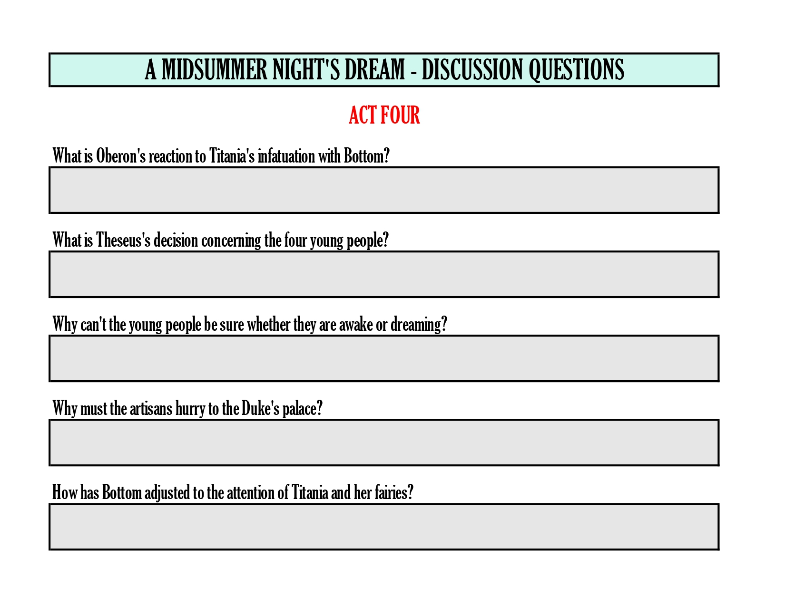
ACT IV - DISCUSSION QUESTIONS

Slide 26

A Midsummer Night’s Dream
Socratic
Seminar
Friday

Slide 27
Scaffolding - Week Five
Act Five - Dialectical Journal
Assigned Readings - Act V - A Midsummer Night’s Dream
A Midsummer Night’s Dream Discussion Questions - Act V
Socratic Seminar Friday
Students Submit Week Four Dialectical Journal and Discussion Questions for Grading

Slide 28

ACT V - DIALECTICAL JOURNAL

Slide 29
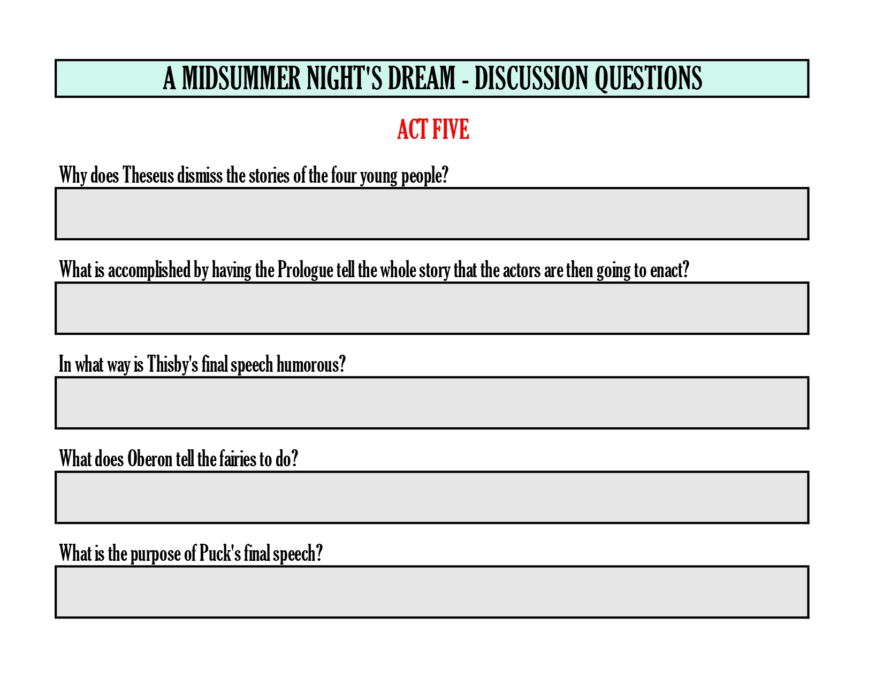
ACT V - DISCUSSION QUESTIONS

Slide 30

A Midsummer Night’s Dream
Socratic
Seminar
Friday

Slide 31
Scaffolding - Week Six
Fun With Kahoot - Vocabulary Quiz
Trickster Archetype Writing Assignment
Lesson: Creating a Video Storyboard
Sample Storyboard - “How Coyote Placed the Stars”
  Storyboard Introduction
  Scenes I - V
Lesson: Create a Movie in iMovie

Slide 32
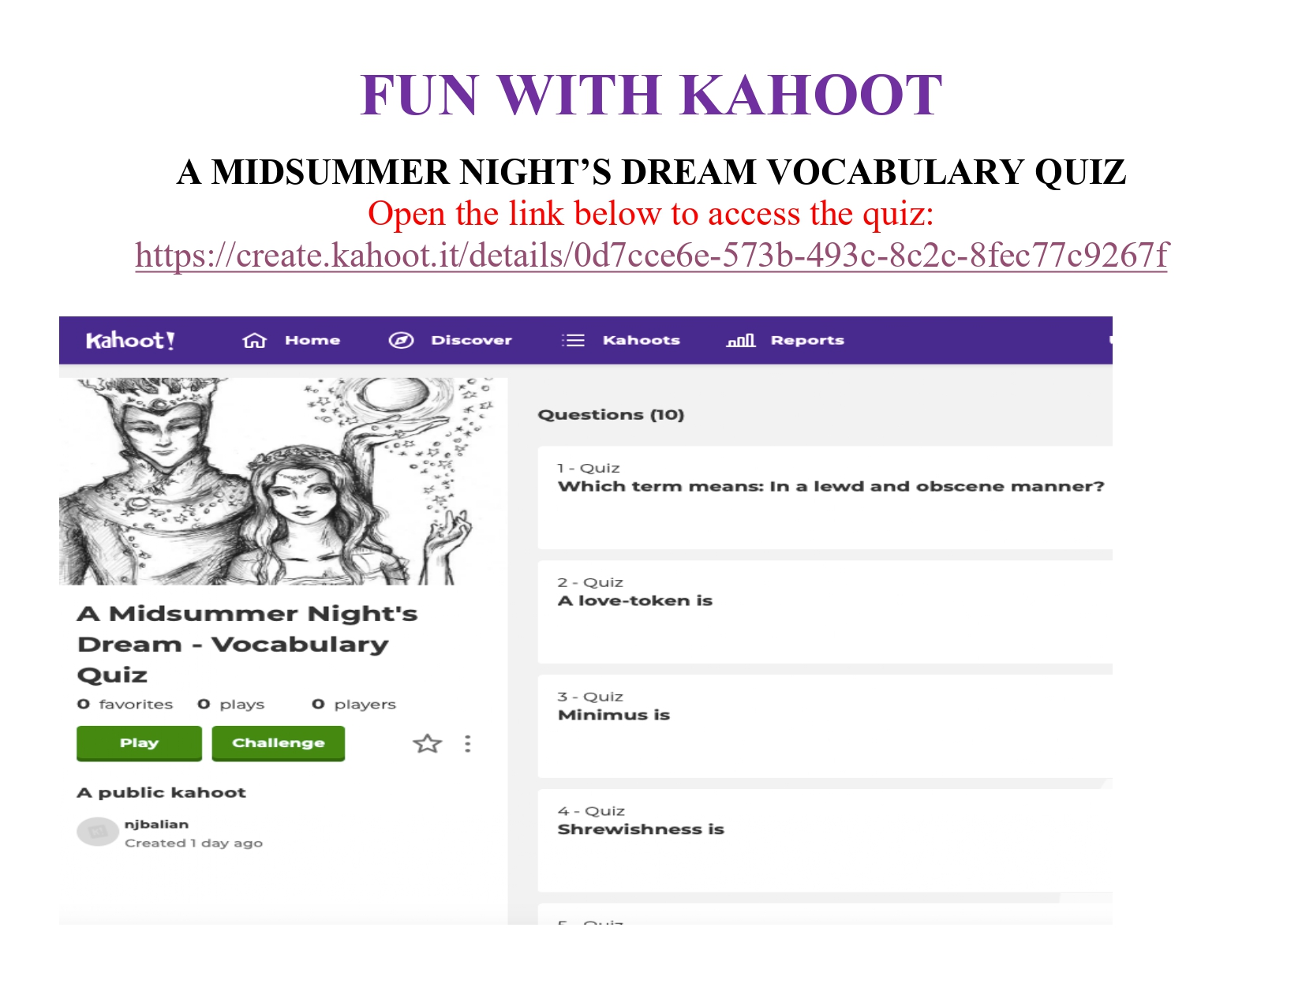
Kahoot Vocabulary Quiz

Slide 33
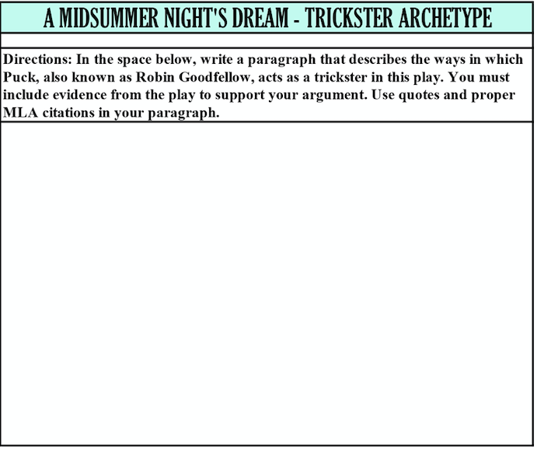
Trickster Archetype Writing Assignment

Slide 34
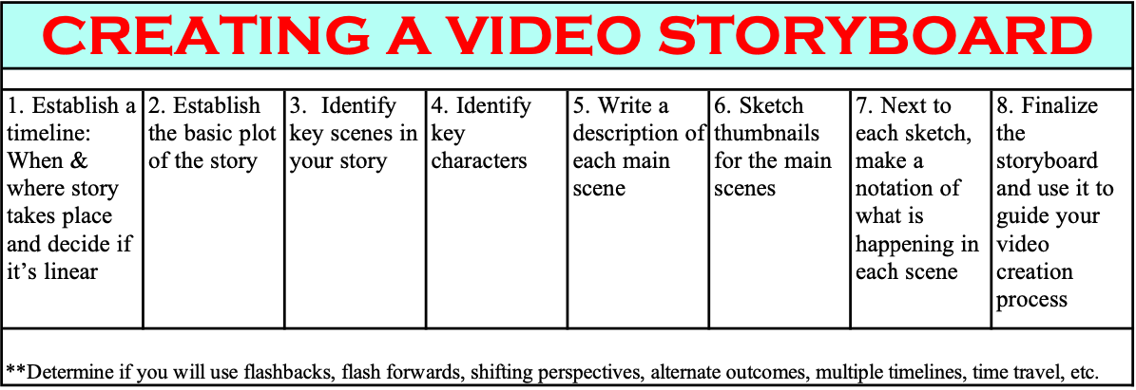
Lesson: Creating a Video Storyboard

Slide 35
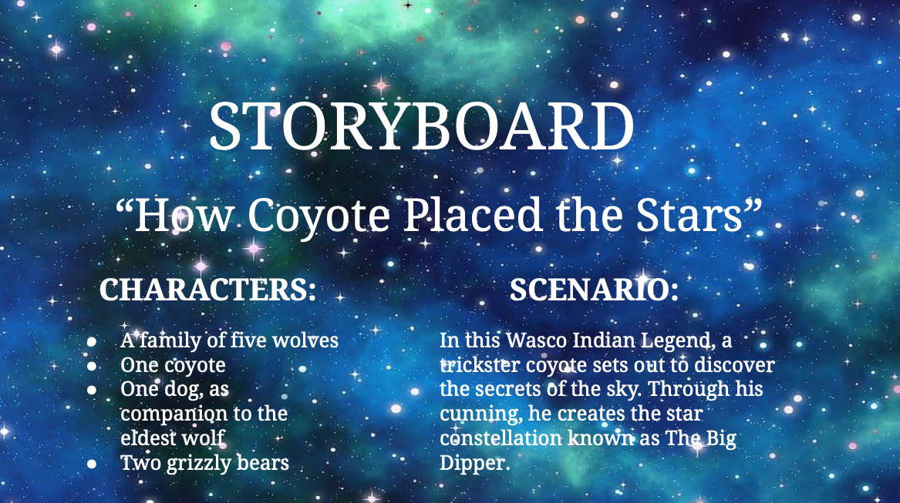

Slide 36
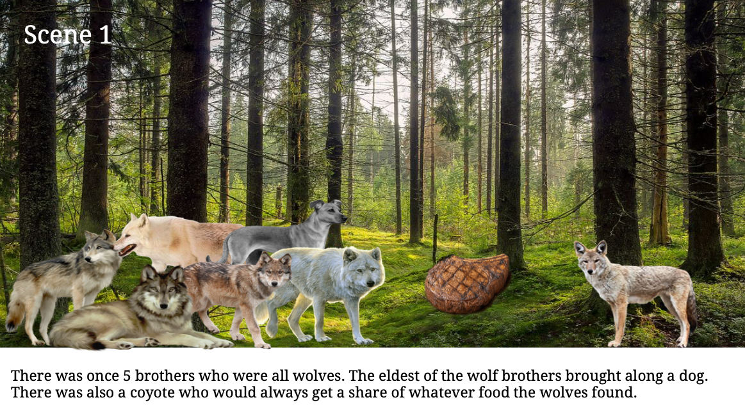

Slide 37
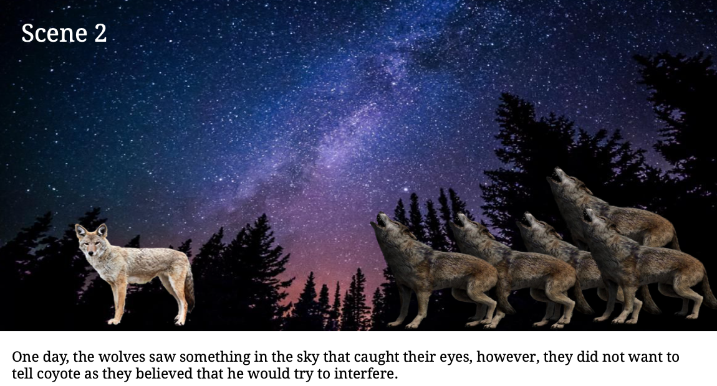

Slide 38
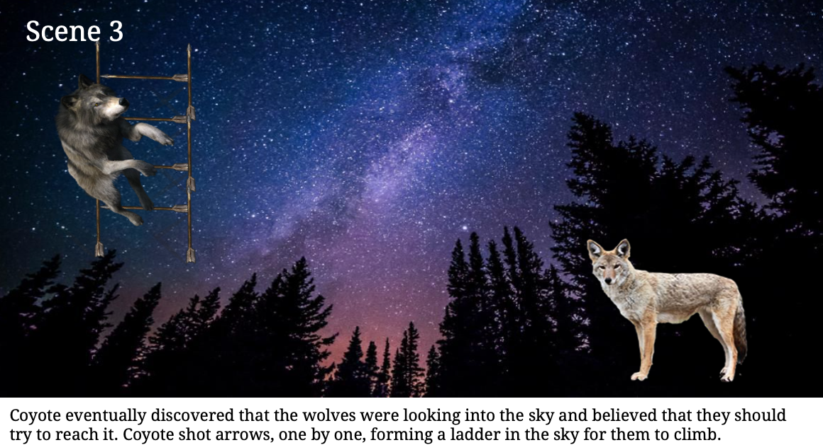

Slide 39
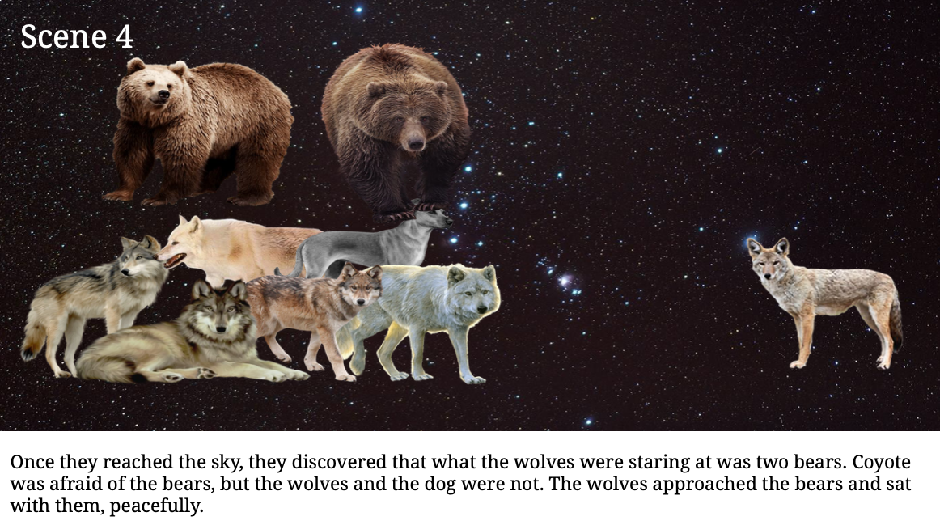

Slide 40
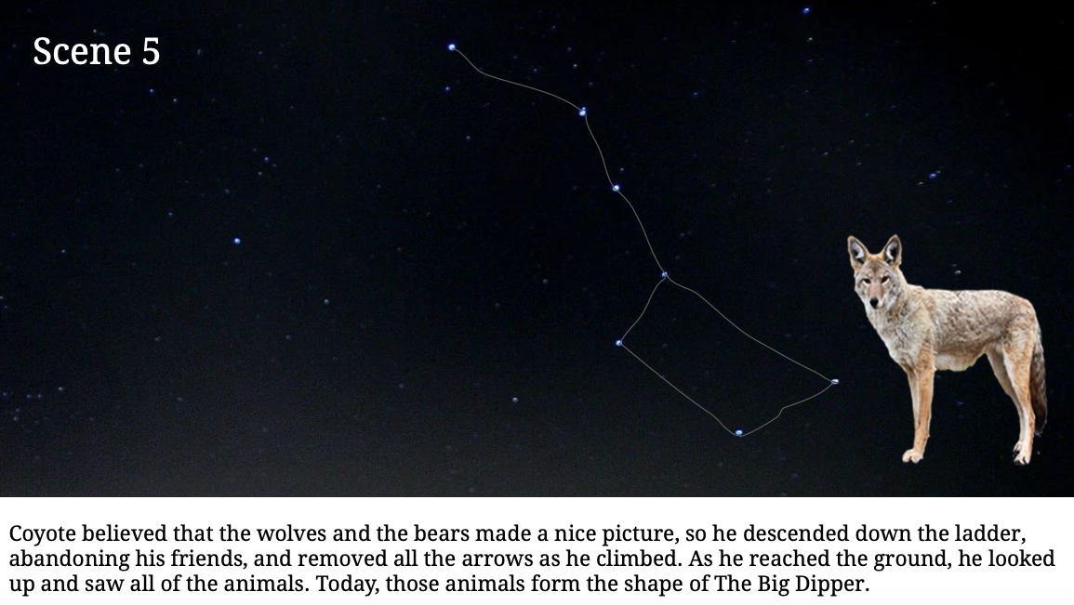

Slide 41

Lesson: Creating a Movie in iMovie

Slide 42
Final Project
The YouTube Video

Slide 43
What Will Be in the Video?
An example of the Trickster Archetype in a 21st century text
  This can be a TV show, Movie, Comic Book, Song, Poem, or Book
Include an intro to the character chosen and the text they are from.
  Must include 1 Character from a text.
    Can include 2 characters from the same text, for example siblings.
The Video needs to be at minimum 5 Minutes long.
Video must include
  the traits that this character shows that are seen in the Trickster figure
  Examples of trickster behavior from the chosen text
    Such as clips, photos, or quotes

Slide 44
What Will Be in the Video? Continued
As a guide, think of how to answer the following questions. Please include an answer to one in your video relating to your proof.
  What clues in the text lead you to see this character as a Trickster?
  Why do you consider this character a Trickster? Is it based on a preconceived notion of trickster or from the listed traits of one?
  Do the other characters in the text refer to them as a Trickster or mischievious?
  Does this character have special abilities like magic or even traits such as being good at persuasion?
Example outline for a video

Slide 45
What will be gained from making a video?
Students will demonstrate their understanding of the characteristics associated with the Trickster figure
Apply the learned tools to contemporary works
CCSS.ELA-LITERACY.W.11-12.6 Use technology, including the Internet, to produce, publish, and update individual or shared writing products in response to ongoing feedback, including new arguments or information.

Slide 46
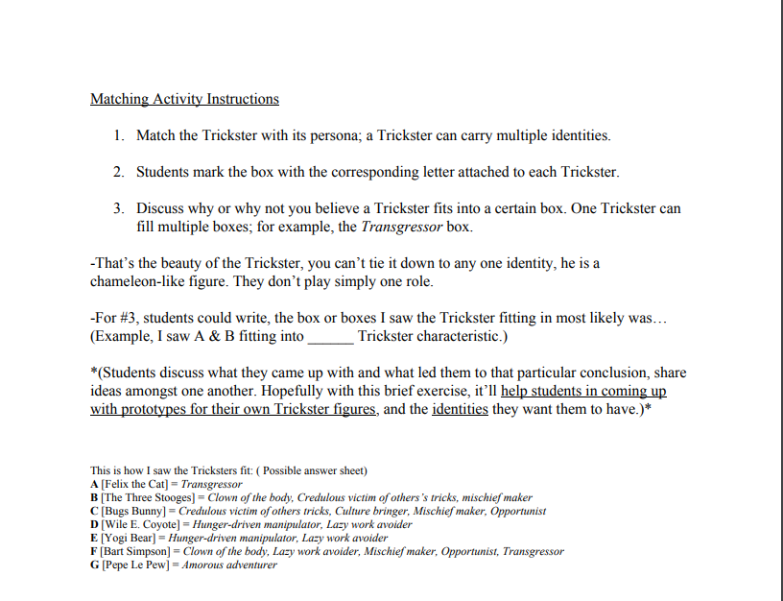
Matching Exercise Instructions

Slide 47
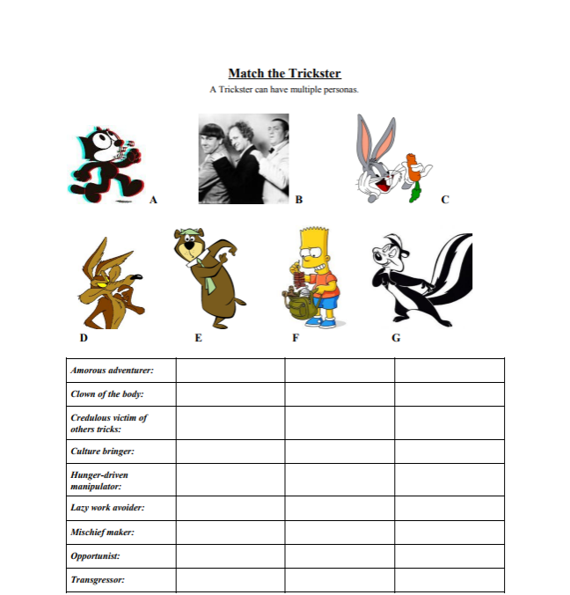
Matching Activity

Slide 48
Kahoot time! (activity demo)
Please go to kahoot.it
Kahoot! | Learning Games | Make Learning Awesome!
Play Kahoot! - Enter game PIN here!
Students will have fun and as well as review what they have learned in class.

